Slide 1

The robot guards itself against collisions
Gouda Ahmed Ashraf 465672
Professor Kirilll Artemov

Slide 2
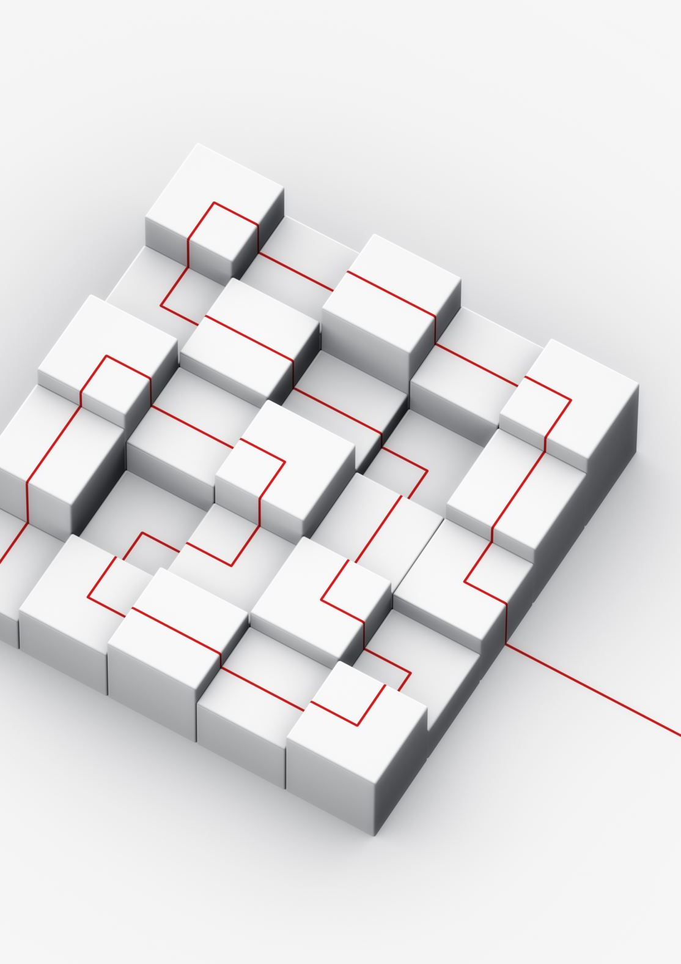
Project Overview
Title: ROS2 Differential Drive Robot: Obstacle Avoidance using Strategy Pattern
Content:
Brief project goal: Implement obstacle avoidance for a differential drive robot with lidar in ROS2.
Key challenge: Flexibly switch between multiple obstacle avoidance algorithms.
Main tools: Python, ROS2, Strategy Design Pattern, SOLID principles.

Slide 3
Motivation
Title: Why Use Strategy Pattern & SOLID Principles?
Content:
Easily switch between different algorithms (Potential Fields, Bug Algorithm, etc.)
Maintain clean, modular, and testable code.
Follow best software engineering practices:
Single Responsibility
Open/Closed Principle
Dependency Inversion

Slide 4
Design: Strategy Pattern
Strategy Pattern StructureContent (diagram or bullet points):
Interface: ObstacleAvoidanceStrategy with method compute_velocity(sensor_data)
Concrete strategies: PotentialFieldsStrategy, BugAlgorithmStrategy, etc.
Context: RobotController uses a strategy object.

Slide 5
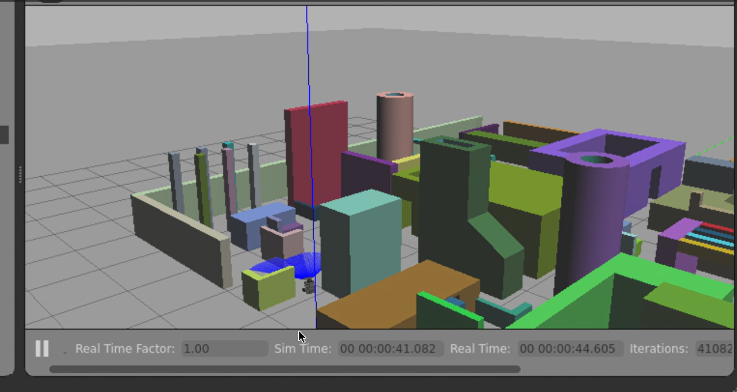
Image from the code

Slide 6
Implementation Highlights
Project Implementation DetailsContent:
ROS2 package structure: modular src/ folder.
Use of Python and ROS2 nodes for sensor data and command publishing.
Ability to switch strategies via ROS2 parameters or config.

Slide 7
Results & Future Work
Results and Next Steps
Content:
Successfully switched between algorithms in simulation.
Smooth obstacle avoidance demonstrated with lidar input.
Future plans:
Add more strategies (VFH, Dynamic Window Approach).
Integrate real robot testing.
Enhance modularity with plugin-based architecture.

Slide 8

Thanks
We are happy to answer any question?

